Slide 1
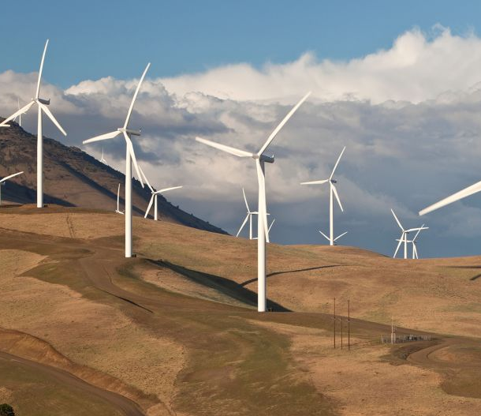
Pole IA – Maintenance Predictive
Ben Silva
Diego Ruiz Ponsoda
Ayoub Ennaiah
Valentin Gérard
Mohammed Ahlal

Slide 2
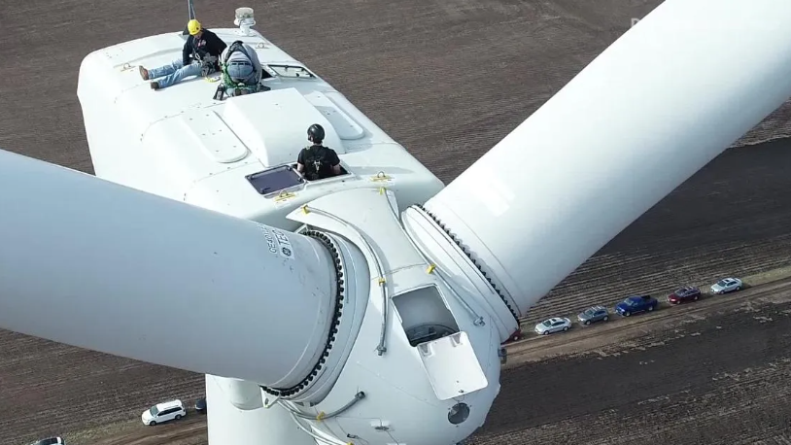
Partie 1 - Context
Description du Projet
Livrables
Plan du Production
Activites des membres

Slide 3

Description du projet
Corrective Maintenance fixes systems when failure has occurred
Preventive Maintenance seeks to avoid failures and outages by repairing or replacing parts before failure
Predictive Maintenance optimises the time between repairs to minimise cost
Matlab has a range of applications used to speed up work flow
Wind Turbines are often in isolated places (off-shore)
Dataset consists of a wind turbine’s history over 50 days preceding failure, with measurements of vibration and tachometer
Notes:
Isolated – work cannot be carried out at any point

Slide 4
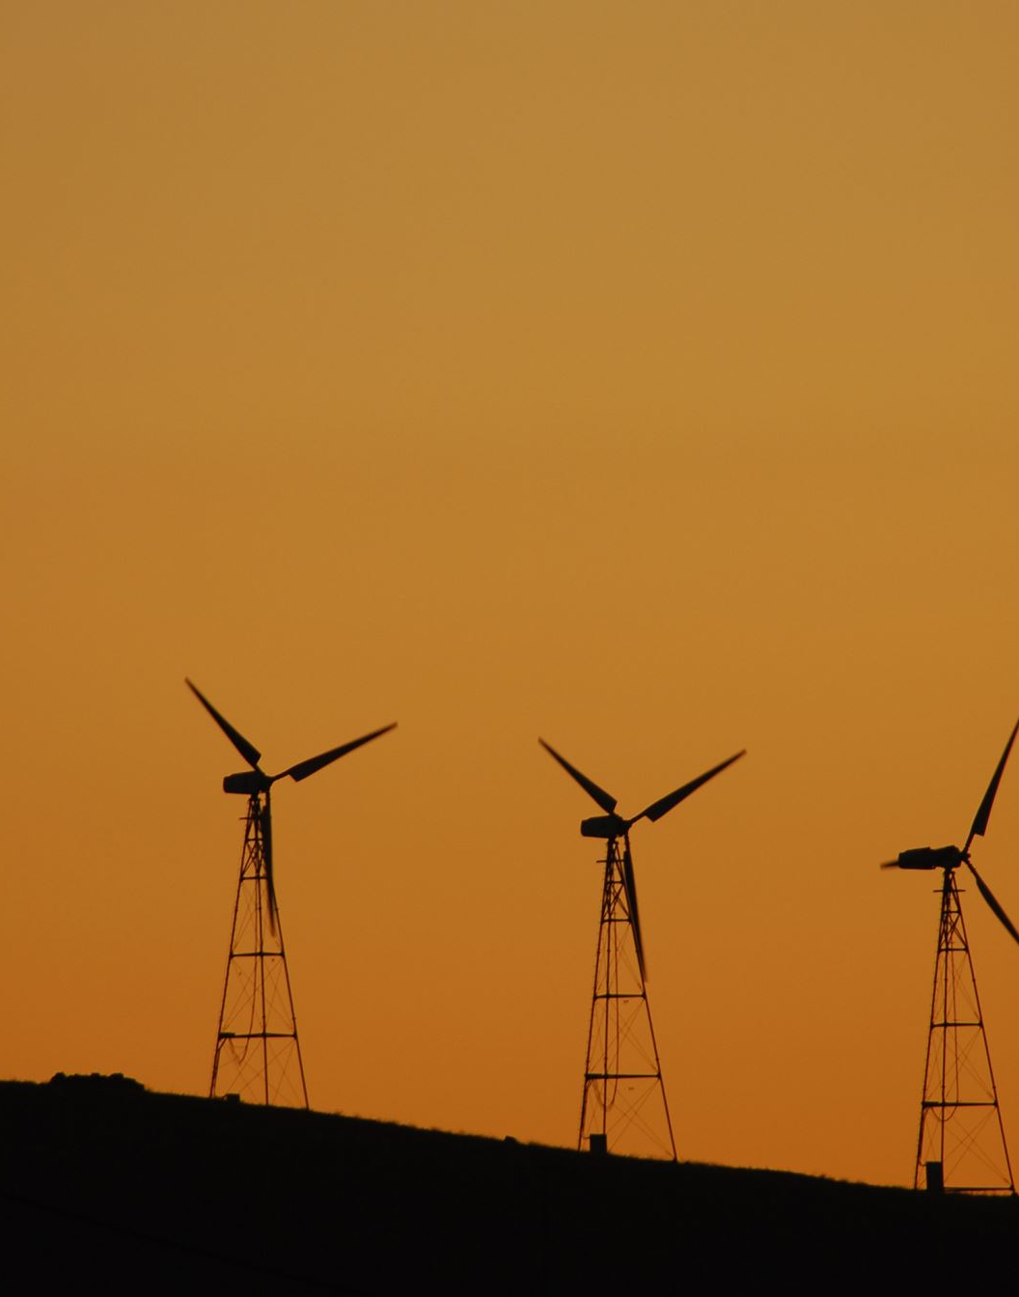
Livrables
Bibliography of predictive maintenance techniques and models
Create a program capable of predicting the RUL of the wind turbine
The program should dynamically recalculate the value as it receives new data
Indicate the confidence bounds of the prediction
Train our model and analyse its performances

Slide 5
Plan du Production
Tâche​ | 2/02​ | 13/02​ | 16/02​ | 1/03​ | 13/03​ | 16/03​ | 23/03​ | 28/03​ | 31/03​
Bibliographie​ | ​ | ​ | ​ | ​ | ​ | ​ | ​ | ​ | ​
Compréhension du dataset​ | ​ | ​ | ​ | ​ | ​ | ​ | ​ | ​ | ​
Recherches de features​ | ​ | ​ | ​ | ​ | ​ | ​ | ​ | ​ | ​
Recherche d'algorithme de régression​ | ​ | ​ | ​ | ​ | ​ | ​ | ​ | ​ | ​
Faire train set/test set​ | ​ | ​ | ​ | ​ | ​ | ​ | ​ | ​ | ​
Mettre en place le réseau de neurone​ | ​ | ​ | ​ | ​ | ​ | ​ | ​ | ​ | ​
Analyse des résultats​ | ​ | ​ | ​ | ​ | ​ | ​ | ​ | ​ | ​

Slide 6

Activités et responsabilités des membres​
Ben – matlab implementation of condition indicators and model
Diego – matlab implementation of feature extraction and selection
Ayoub – bibliographie on feature extraction
Valentin – organisation of the team, documentation
Mohammed – bibliographie on predictive maintenance techniques & models

Slide 7
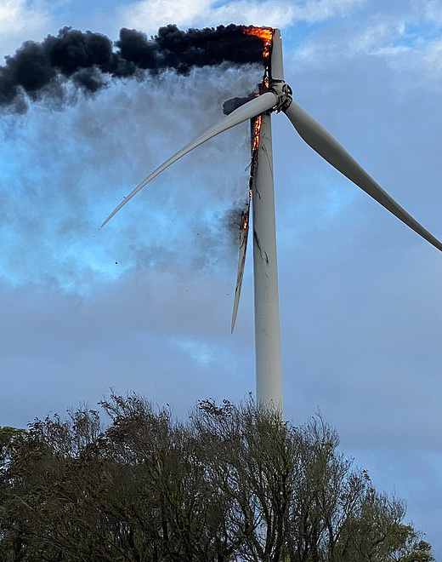
Partie 2 – Activités Realisés
Bibliographie
Feature Extraction
Condition Indicator
Modèle de degradation

Slide 8
Bibliographie
Matlab Predictive Maintenance e-book
https://www.mathworks.com/content/dam/mathworks/ebook/gated/predictive-maintenance-ebook-all-chapters.pdf
Matlab video series
https://uk.mathworks.com/videos/series/predictive-maintenance-tech-talk-series.html
Matlab Anomaly Detection
https://uk.mathworks.com/videos/introduction-to-anomaly-detection-for-engineers-1663930223584.html
Processing for Improved Spectral Analysis
Eric Bechhoefer et al.

Slide 9

Data Pre-Processing
Normally data will be provided with many problems that render it unsuitable for training a model
Could include:
Missing samples
Incorrect or missing labels/formatting
Outliers
Scaling
Our data was provided pre-processed so no cleaning was required
Remains important to keep in mind when considering ML workflow

Slide 10
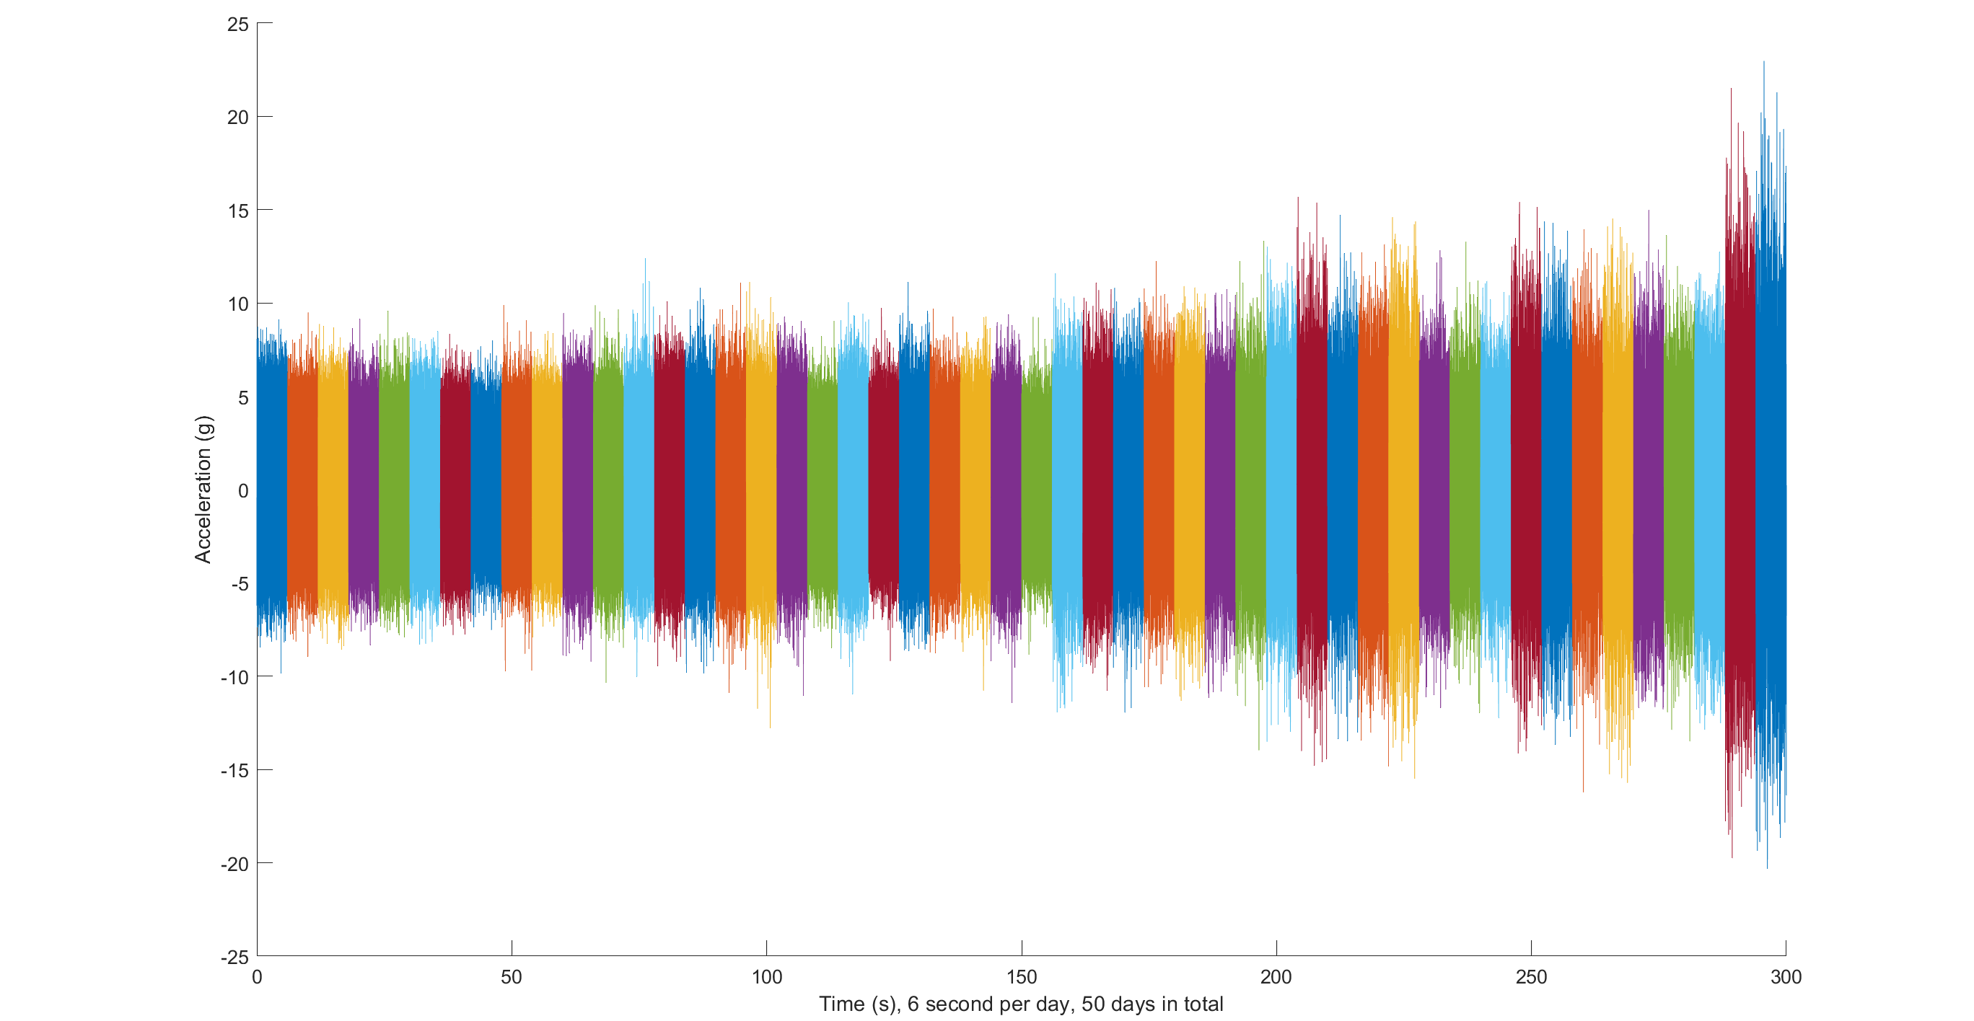

Slide 11
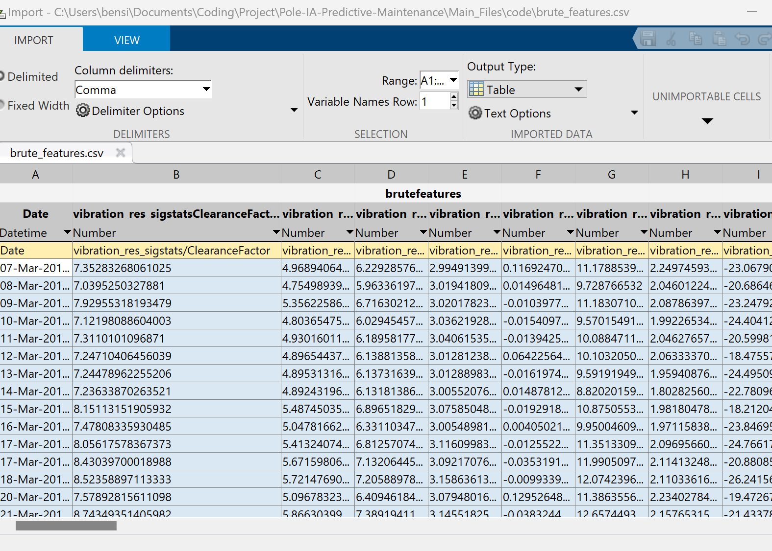
Feature Extraction
We used Diagnostic Feature Designer from the Predictive Maintenance Toolbox to bulk extract over 100 different features
The tachometer data needed to be differentiated to give a useful signal. Differentiating twice gives us the acceleration.

Slide 12
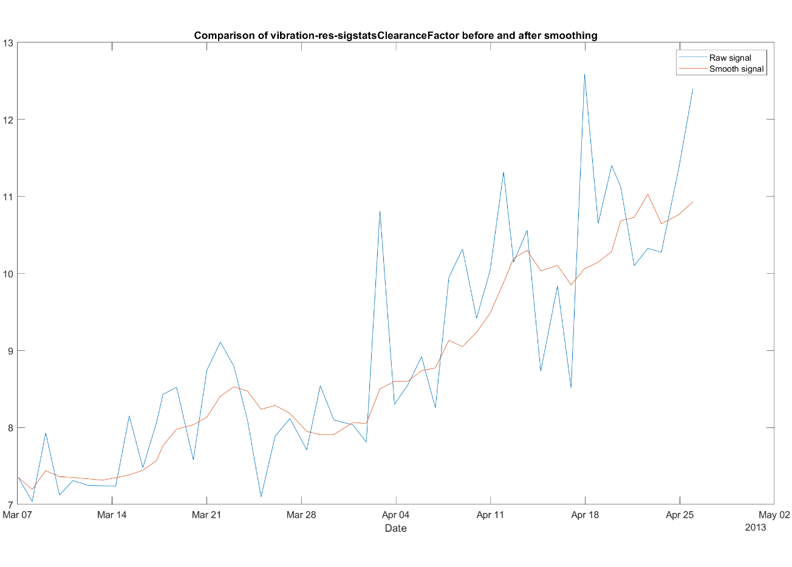
Feature Smoothing
We used a 5 day moving average to smooth the data
In all measurements there is signal noise or high frequency components which are not useful for predicting long term behaviour
Introduces a time lag

Slide 13
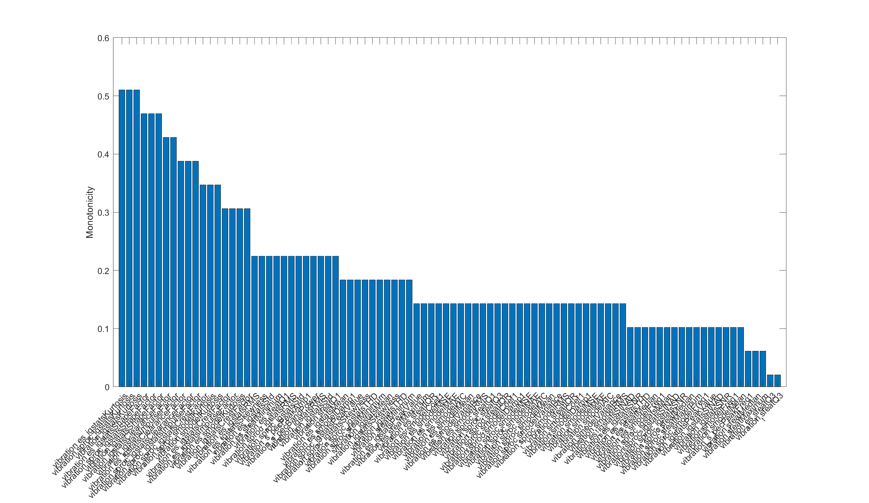
Ranking Features
More features = longer training time and risk of overfitting
We want to select only the features whose inclusion will improve the model
We can do this by calculating the monotonicity of each feature
Monotonicity means that as the target variable increases, so does the feature
Data needed to be smoothed first
Monotonicity of over 0.3 was kept, leaving 19 features
Notes:
Eg if vibration amplitude increased but standard deviation remained constant, s.d. wouldn’t be useful

Slide 14
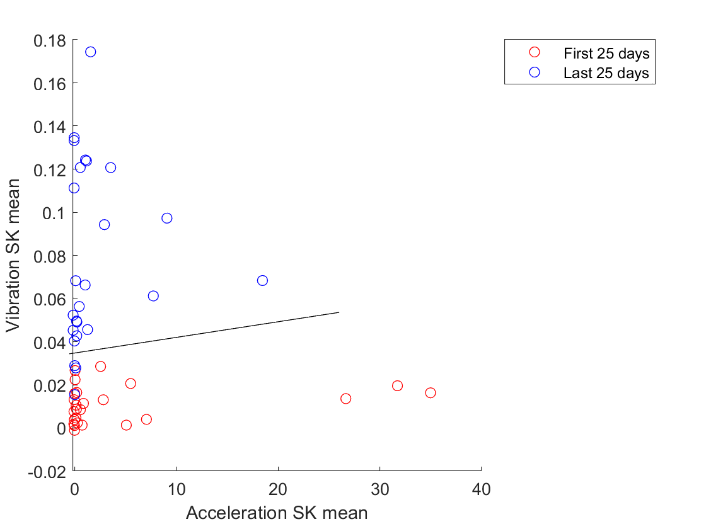
Neural Network
We initially tried to find features that could be used to classify the data points into distinct groups (healthy or faulty)
However this technique is best used when there are several distinct fault types, and as we only have one fault type in our history, it is not useful
We used the Classification Learner in Matlab with a wide neural network

Slide 15
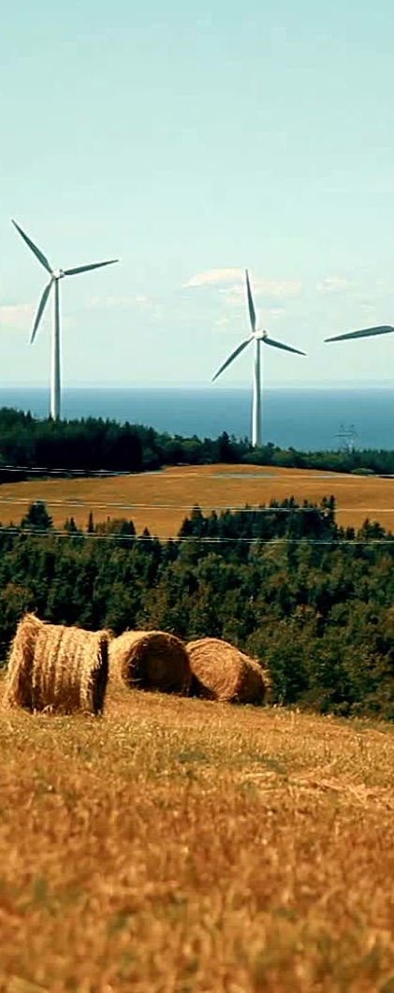
Condition Indicator
After selecting our features, we want to combine then into one condition indicator
With this we can train our degradation model
We need to scale features between 0 and 1
We can use principal component analysis to combine multiple features into one variable
For this approach, we need some a priori knowledge about the type of wind turbine, to know at what condition level the turbine will fail at
This can be taken from the fleet history

Slide 16
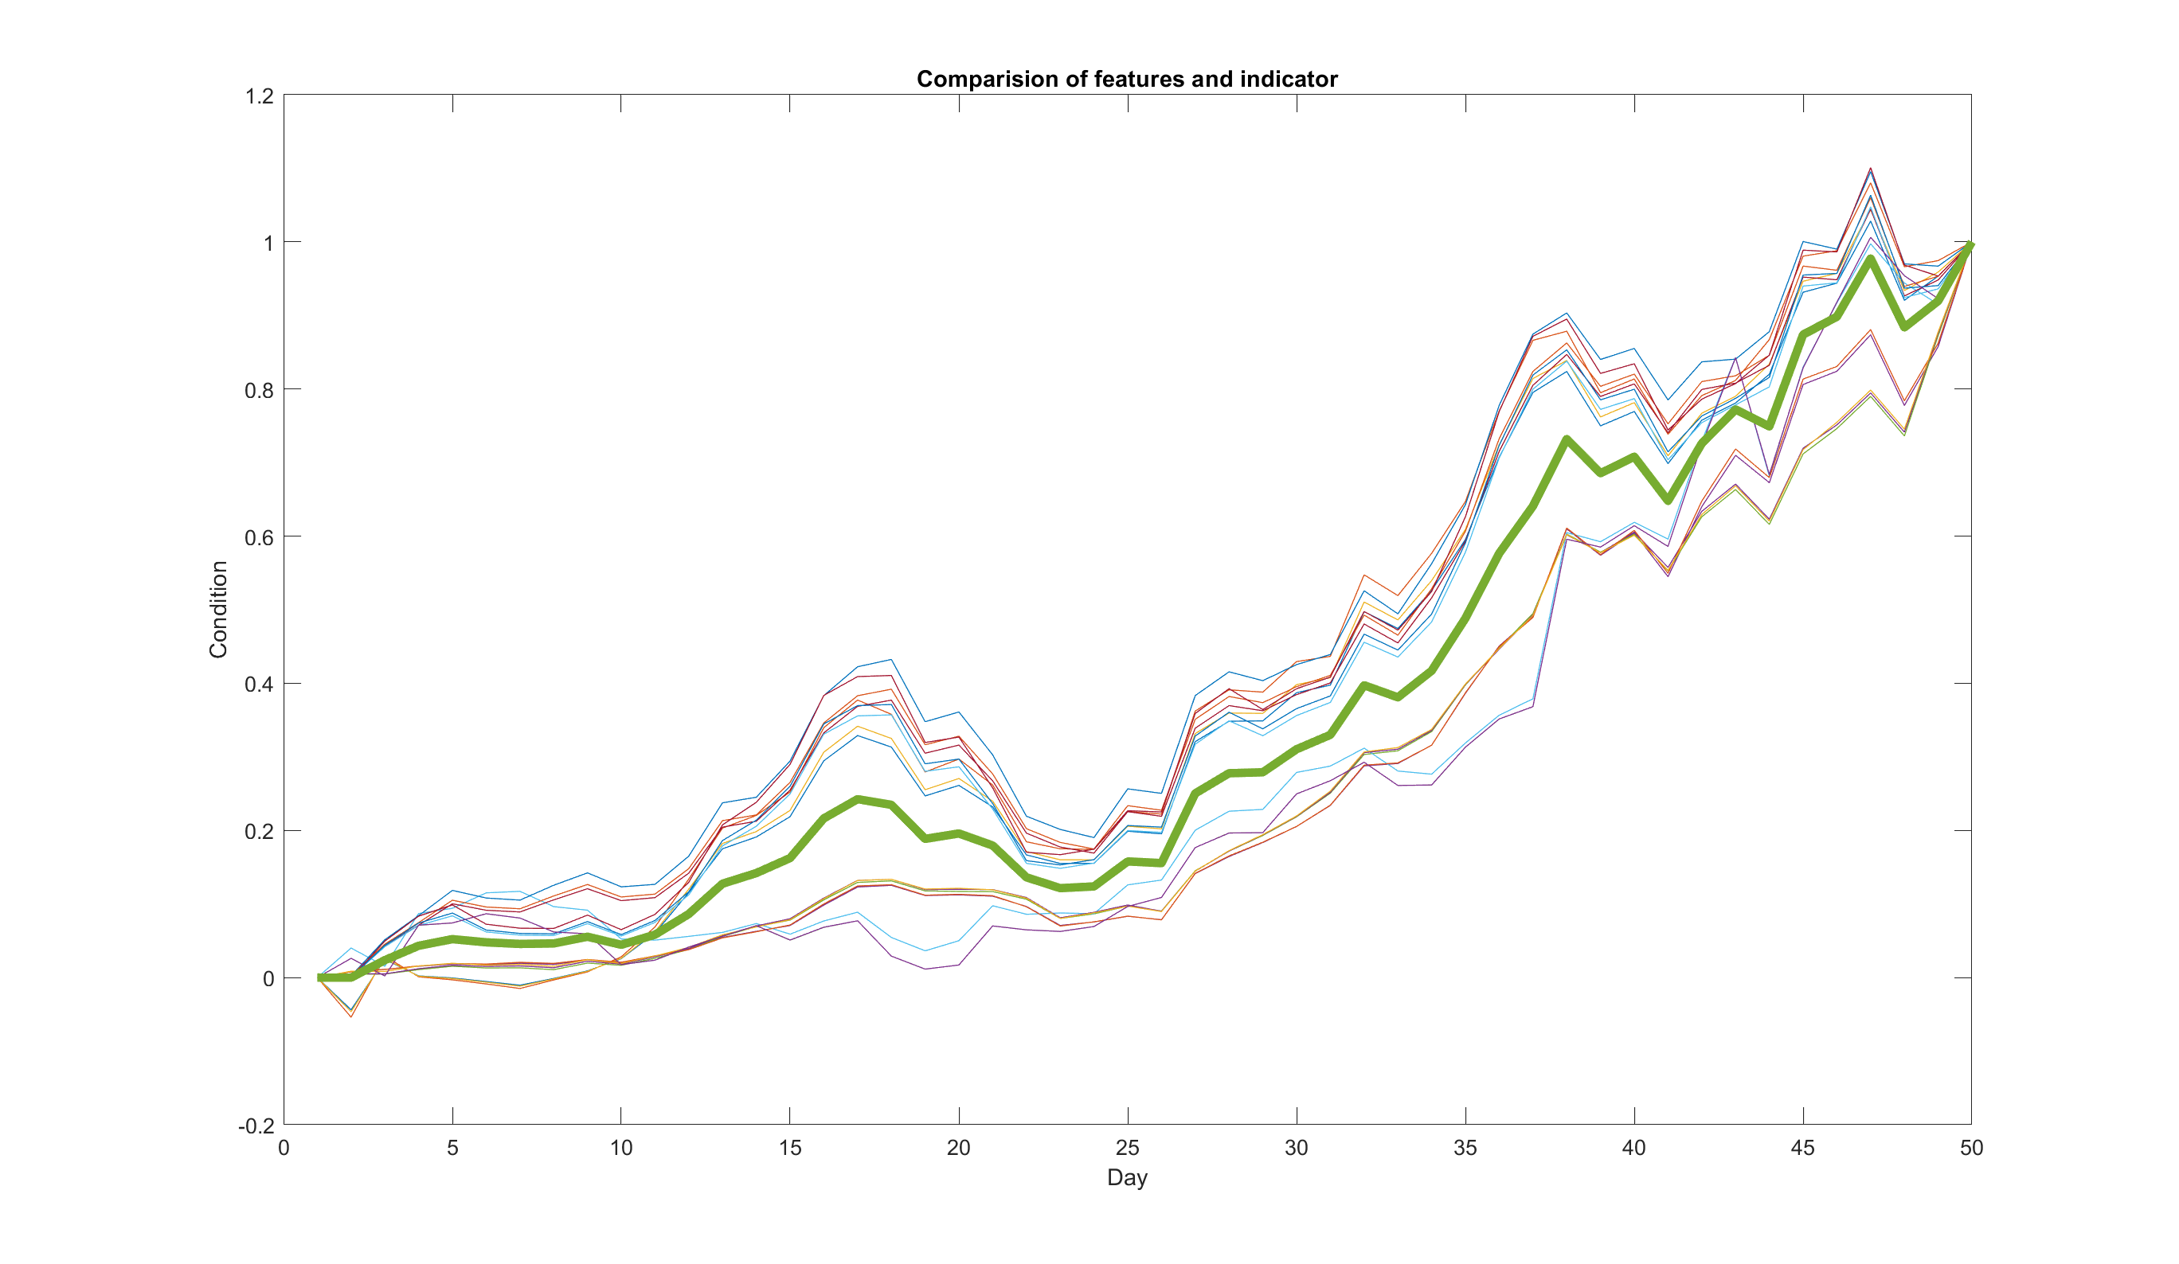
Equal weighting for all features

Slide 17
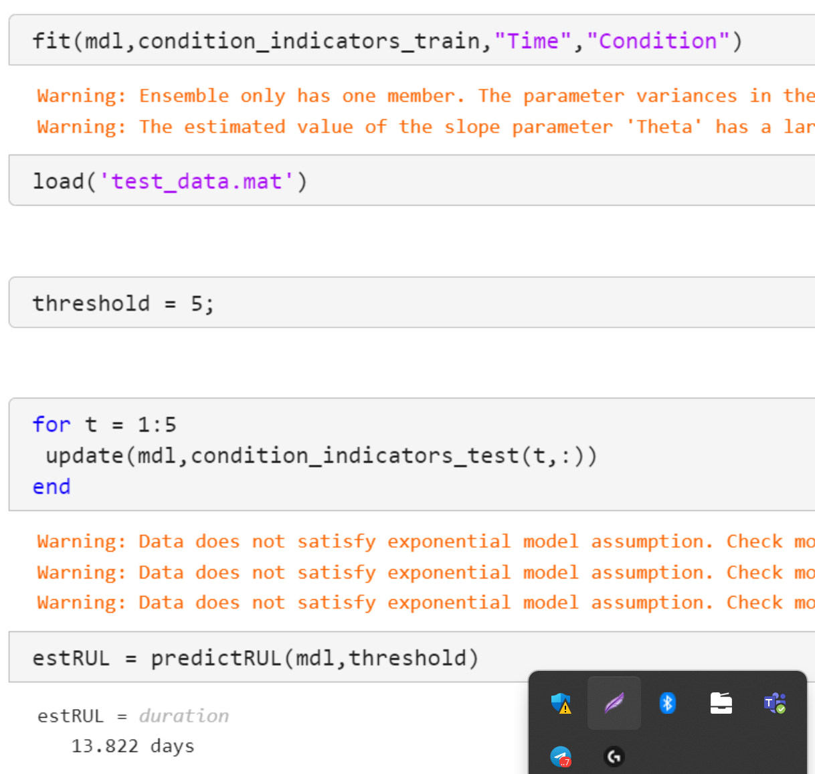
Degradation Model
We use the exponential degradation model in matlab
We train it on (for example) the first 30 days, then we give it the data for the 31st day and it predicts the RUL
As we are yet to optimise our condition indicator weighting, or our train/test set, the results are still inaccurate
Current accuracy is predicting 14 days RUL when real time to failure was 5 days
No graphical animation created yet

Slide 18

Prochaines Etapes
Train/Test set
Amelioration de modèle
Intervalle de confiance
Analyse performances

Slide 19
Plan du Production Futur
Tâche​ | Semaine 9​ | Semaine 10​ ​ | Semaine 11​ ​ | Semaine 12​ ​ | Semaine 13​ ​ | Semaine 14​ ​ | Semaine 15​ | Semaine 16​ ​ | Semaine 17​ ​
Etat de l’art​ | ​ | ​ | ​ | ​ | ​ | ​ | ​ | ​ | ​
Création de l’indicateur​ | ​ | ​ | ​ | ​ | ​ | ​ | ​ | ​ | ​
Rapport intermédiaire​ | ​ | ​ | ​ | ​ | ​ | ​ | ​ | ​ | ​
Présentation intermédiaire​ | ​ | ​ | ​ | ​ | ​ | ​ | ​ | ​ | ​
Implémentation de modèle dégradation​ | ​ | ​ | ​ | ​ | ​ | ​ | ​ | ​ | ​
Test/train set​ | ​ | ​ | ​ | ​ | ​ | ​ | ​ | ​ | ​
Ajouter variance / Intervalle de confiance a prediction RUL​ | ​ | ​ | ​ | ​ | ​ | ​ | ​ | ​ | ​
Analyse résultats​ | ​ | ​ | ​ | ​ | ​ | ​ | ​ | ​ | ​
Présentation Finale​ | ​ | ​ | ​ | ​ | ​ | ​ | ​ | ​ | ​
Rapport Final​ | ​ | ​ | ​ | ​ | ​ | ​ | ​ | ​ | ​
Date fixé
Note: Ben and Mohammed start Maintenance and Industry 4.0 elective

Slide 20
Questions?

